Slide 1
Progress on the Update of Economic Statistics and National Accounts in the Arab Region
تحديث الإحصاءات الاقتصادية والحسابات القومية في المنطقة العربية
The Tenth Meeting of The Steering Committee of The Arab Statistics Initiative (Arabstat)
8-9 November 2023 - Abu Dhabi - U.A.E.
Wafa Aboul Hosn, Ph.D.
Chief of Economic Statistics, Information Society and Technology Cluster
Email: aboulhosn@un.org

Slide 2
Content
Update of the SNA 2025
UN-Network of Economic Statisticians UN-NES-Sprints-Beyond GDP
International Trade in Goods (New Dashboard) and Study on Measuring Digital Trade, Statistical Business Registers
CPI, ICP and HCPI
Big Data Task Teams in Economic Statistics
South-South Cooperation

Slide 3
I- ESCWA’s Work on the UPDATE of the SNA 2025
Technical research
    [Sub/Joint] Task Teams
    Specific timeline and outputs
    Draft guidance notes: clarification, interpretation or change;
      implementation tested through country experimentation and testing
GUIDANCE NOTE ON ISLAMIC FINANCE
With GCC-Stat UNSD: 4 Countries Pilot Testing
experimentation and testing
Broad consultation
    Involve broad set of users in the discussion, including policymakers, academia and private sector representatives
    Regular regional and global consultancies;
    Global user conferences on economic statistics
Regional Workshop on SNA Update
Ensuring overall consistency
    Collaborate with experts in: classifications, BPM, GFSM, MFSM, SEEA, labor, prices, agriculture, and business and trade statistics, etc.
BOP and SNA Co-Chairs

Slide 4
UN-Network of Economic Statisticians
United Nations Network of Economic Statisticians UN-NES
    ESCWA reached out to Economists and Social Scientists withing the organization and a wide network from countries and organizations (Morocco, Tunisia, Palestine, Oman)
    Encouraged Arab Countries to establish their national networks of Economic Statisticians
    Engaged in regional consultations and communication
  Sprints on Economic Statistics
      Classifications,
      Measurement of Inflation of Owner-occupied Housing Sprint,
      Beyond GDP
Notes:
The Central Role of Statistical Offices: extending the statistical framework to and invest in measuring wellbeing, inclusion, and sustainability measures in addition to GDP
Responding to policy priority in the Arab Region: for Integrating economic, social, and environmental information into extended accounts and meaningful and actionable dashboards of indicators and indexes to measure wellbeing, inclusion, and sustainable development for which statistical systems in Arab Countries should be ready to implement

Slide 5
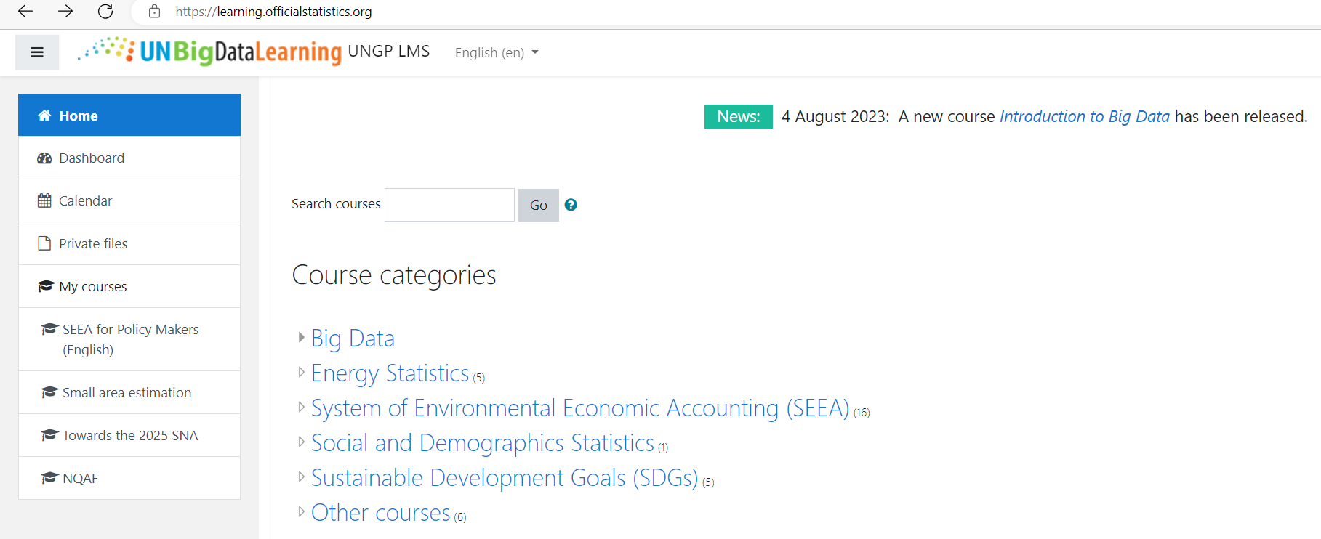

E-learning for Capacity Building
learning.officialstatistics.org/
Towards the 2025 SNA
This e-learning material was designed to help users interested in the SNA update to access various resources related to the update process, some of the main topics included in the update, and country experiences with the new topics. The site provides material and links to some of the general webinars and topical webinars held for the SNA update. This is a joint UNSD, ECLAC, ESCAP, ESCWA, UNECA, and UNECE effort.
Towards the 2025 SNA (officialstatistics.org)
Towards the 2025 SNA (officialstatistics.org)

Slide 6
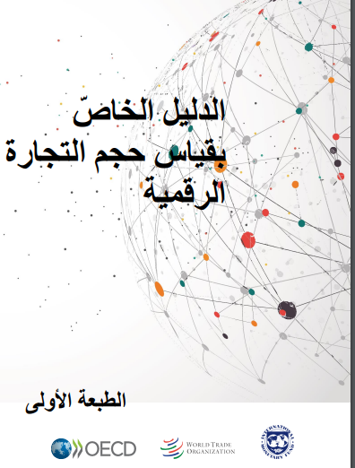
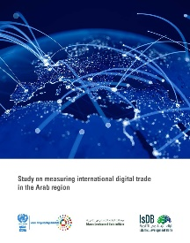
II-International Trade in Goods (New Dashboard) and Study on Measuring Digital Trade, Statistical Business Registers
Measuring Digital Trade قياس التجارة الرقمية AMF-WTO-ESCWA 20-23-11-2023 Abu Dhabi
Statistical Business Registers with UNSD and AITRS in January 2024
Energy data workshop – MENA region 12 Oct 2023 Workshop — Paris, France
الدليل الخاصّ بقياس حجم التجارة الرقمية,
Study on measuring international digital trade in the Arab region E/ESCWA/CL4.SIT/2022/TP.1 March 2022

Slide 7
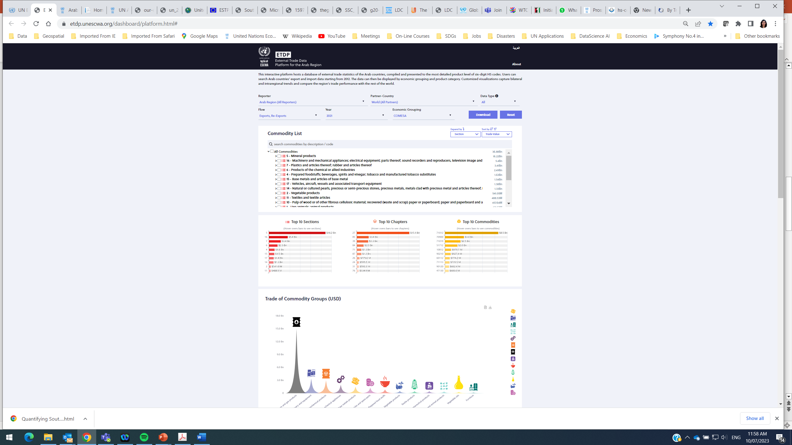
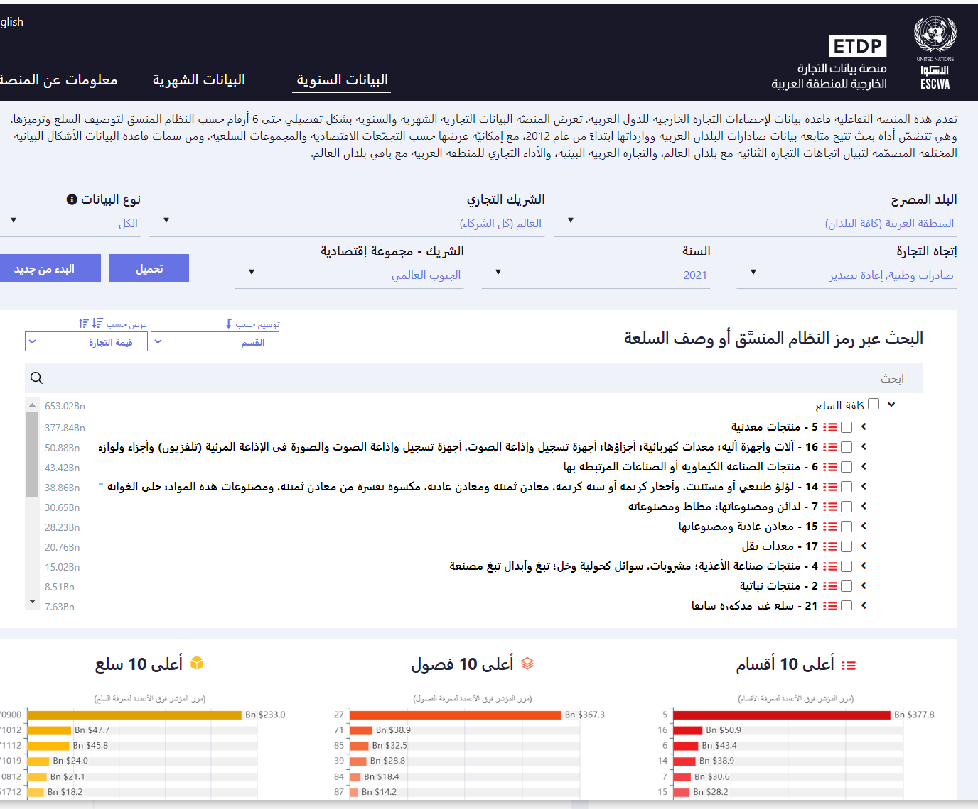
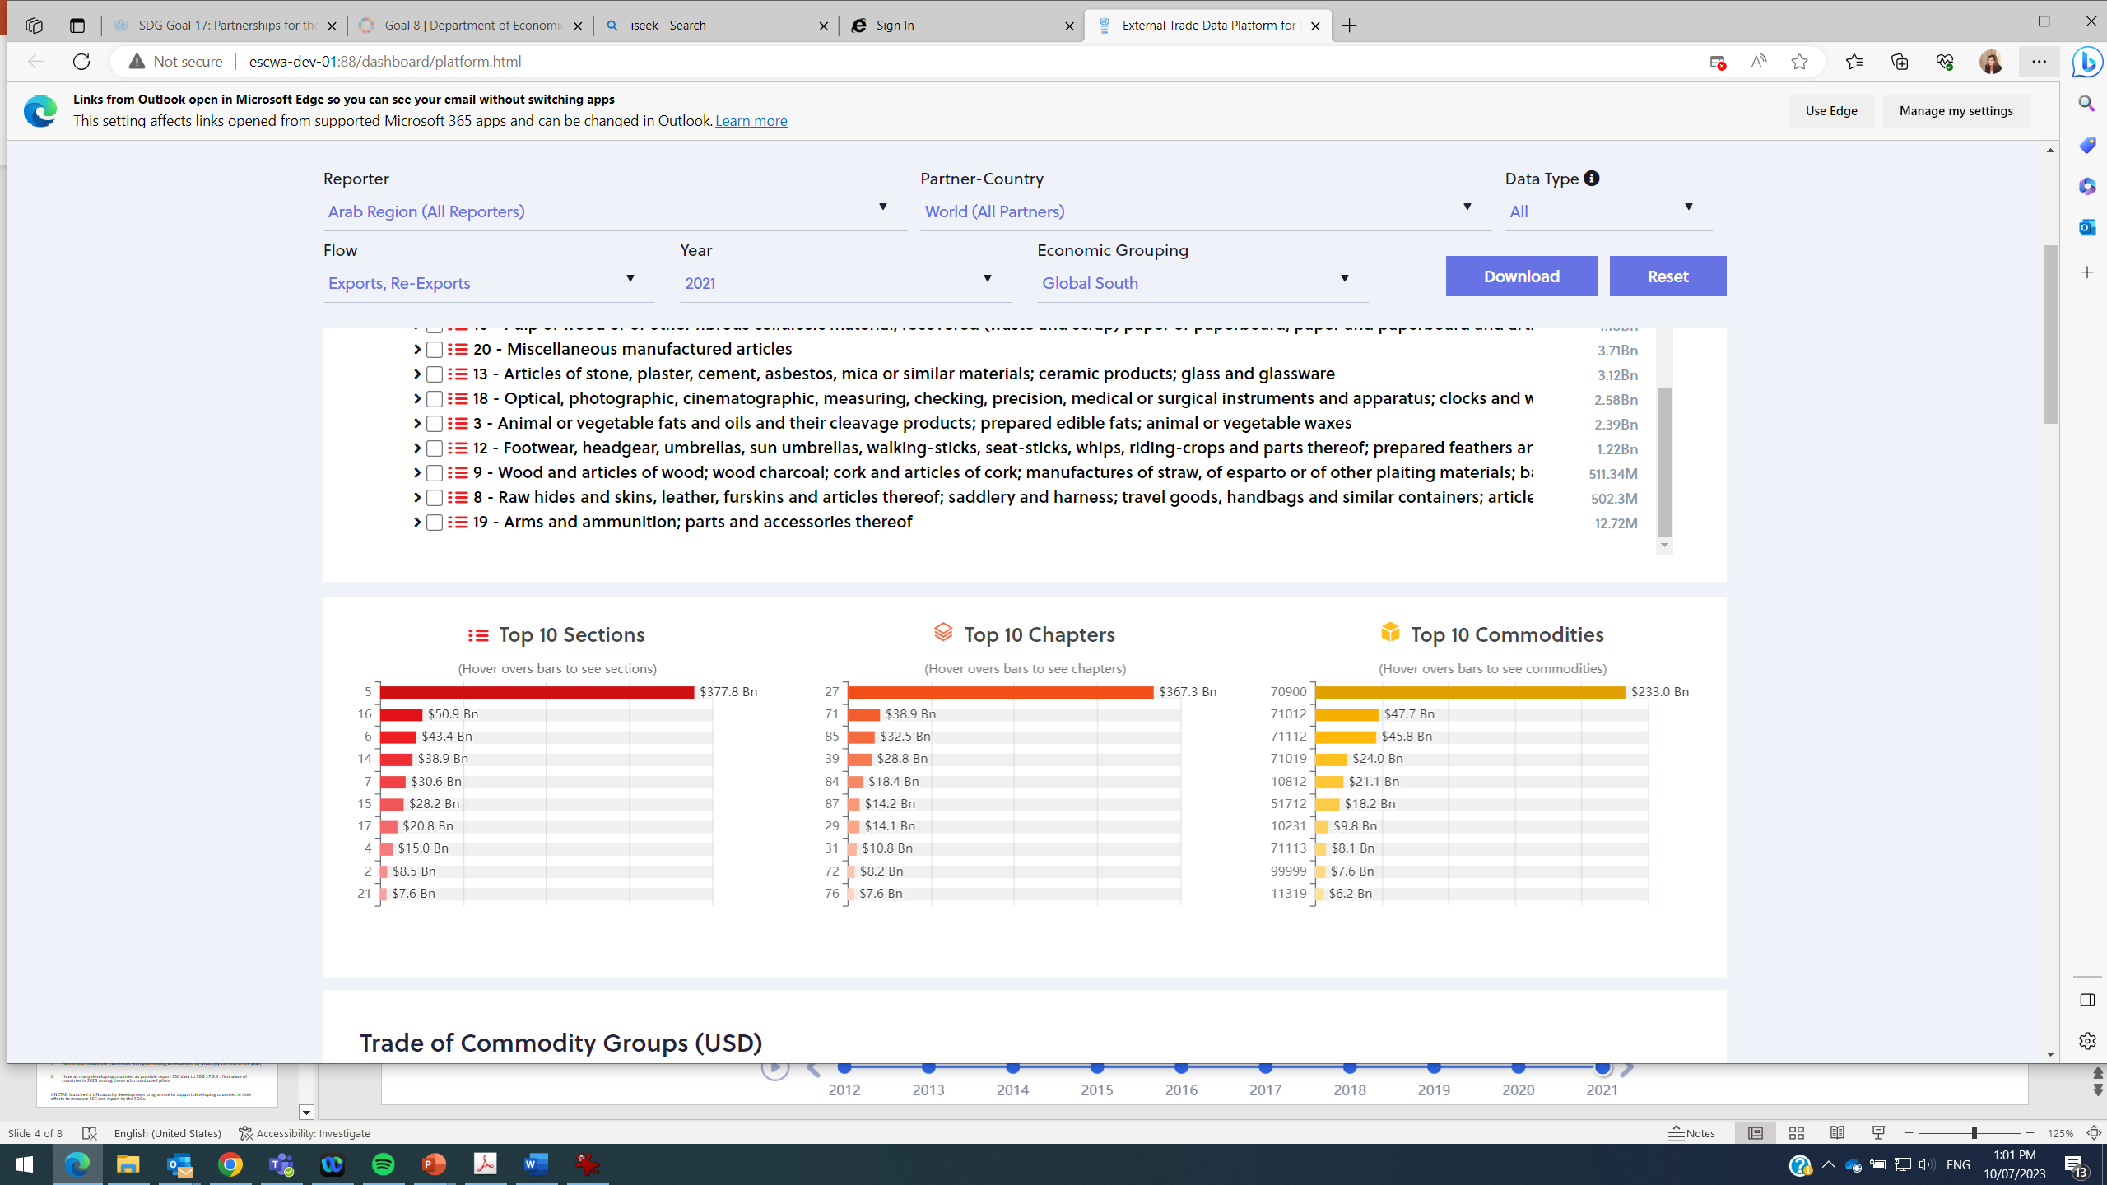
Trade in Goods: ESCWA External Trade Data Platform for the Arab Region (ETDP)
https://etdp.unescwa.org/dashboard/platform.html#

Slide 8
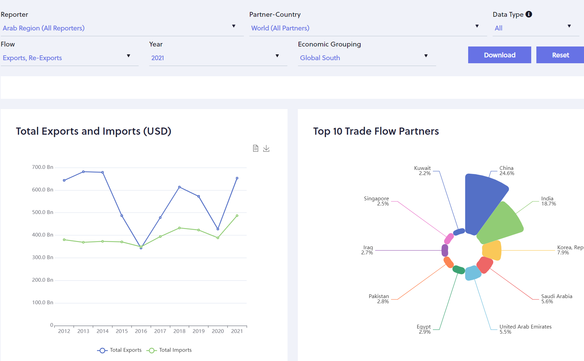
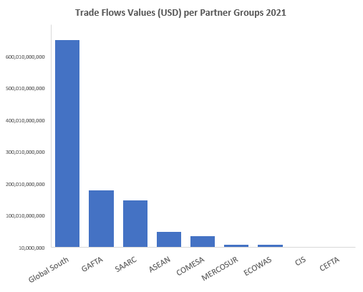
Trade in Goods: ESCWA External Trade Data Platform for the Arab Region (ETDP)
Growth rate 2% for exports 28% form imports from 2012 to 2021

Slide 9
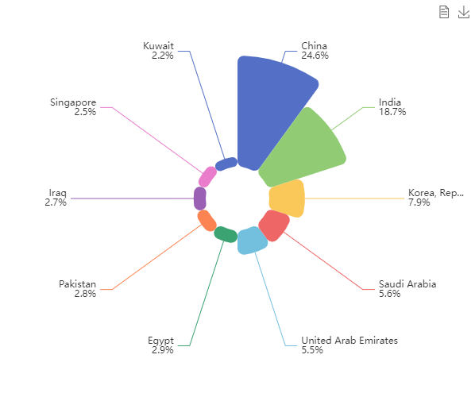
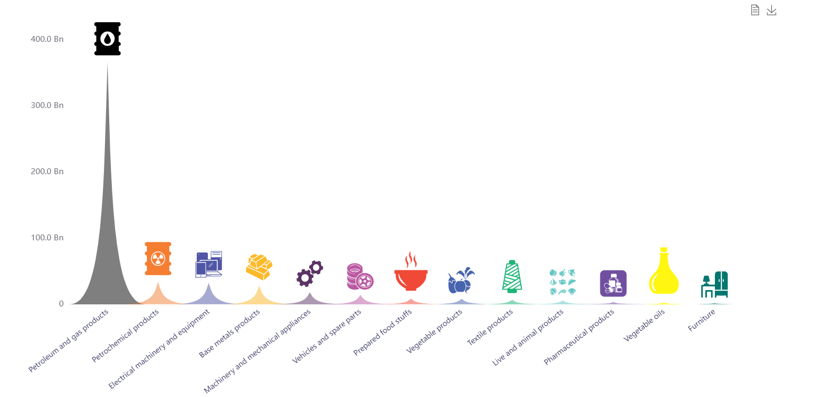
Trade Flows by Reporter and (USD) and Top 10 Trade Flows Partners for 2021
Top 10 Trade Flows Partners
Trade of Commodity Groups

Slide 10
III- Work on Price Statistics
Purchasing power parity estimates PPPs
Constructing an annual long time series
2011-2012-2013
2021-2022-2023
Continue
2016
Extrapolation methodology
The complete PPP production cycle coincides with the 2021 ICP global cycle PPP calculation for the period
Complete cycle of producing regional PPPs with actual data collection
Back Casting prices 2014 and 2015 from 2016
Improved Forecasting Methos
2014-2015
2017-2018-2019-2020
Regional Price Statistics Meeting: Impact of price changes on social and economic indicators. (November postponed till 6-7 December 2023)

Slide 11
New Regional Products on Price Statistics
HARMONIZED CONSUMER PRICE INDEX (HCPI)
Improving the consumer price index
CPI
ICP
Investing knowledge by producing annual regional PPPs
HCPI for GCCs
HCPI for Non GCCs
HCPI for Arab Region
Double integration process to increase the overlap between the regional list of household consumption items and the national CPI item lists.
Improving the national CPI, increasing the description of items by adding items extracted from the regional ICP list
Strengthening the national data refinement process by adopting ICP data processing methods and tools
Regional ICP list becomes more representative of the Arab region by including items extracted from the national CPI regulations.
Notes:
إنتاج مؤشر أسعار موحد لمنطقة دول مجلس التعاون الخليجي
استثمار المعرفة من إنتاج مماثلات قوة شرائية إقليمية سنوية

Slide 12
Big Data Task Teams in Economic Statistics
https://unstats.un.org/bigdata/task-teams/index.cshtml
ESCWA member of Task teams and use cases in the following:
AIS data: analyses the usage of data coming from the Automatic Identification System (AIS) : Use Case on Marine Shipping Dynamics in Mediterranean Sea after Ukraine War
Mobile Phone Data: Mobile Records for Refugees Mobility in Lebanon and Jordan
Scanner Data: for Prices
Earth Observation: SDGs, Disasters Monitoring, and Damage Assessment

Slide 13
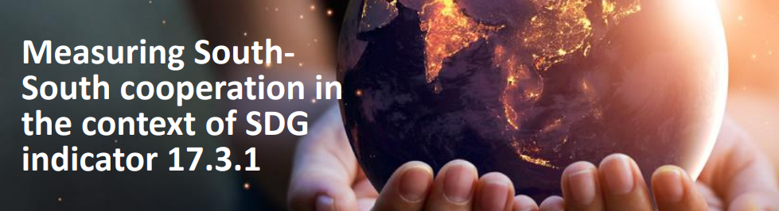




South-South Cooperation for Knowledge Sharing Background
UNSD ECA ECLAC ESCAP ESCWA
https://unctad.org/project/quantifying-south-south-cooperation-mobilize-funds-sustainable-development-goals

Slide 14
DA Project 2023-2025 in the Arab region
https://unctad.org/project/quantifying-south-south-cooperation-mobilize-funds-sustainable-development-goals
Engagement from our Region to refine and Validate the Conceptual framework to measure and report South-South cooperation
Data collection, compilation and reporting tools developed based on discussions in an expert meeting (with experts nominated by governments)
Organize one regional event, to disseminate the conceptual framework and the goals/objectives of measuring South-South cooperation and identify interested countries.
Inter-regional capacity building workshop
National workshops in beneficiary countries to test and adapt the validated framework, tools and resources to the national context
An e-learning course (We can translate into Arabic) to support measurement and reporting of South-South Cooperation.
Sharing the SSC framework, tools and resources in national and international events of statisticians
A report summarizing the methodology and the findings, including early estimates of South-South Cooperation
National On-line platform for data collection

