Slide 1
Data Collection and Frameworks for Environment Statistics and Accounts in the Arab Region
جمع البيانات وأطر الإحصاءات والحسابات البيئية في المنطقة العربية The Tenth Meeting of The Steering Committee of The Arab Statistics Initiative (Arabstat) 8-9 November 2023 - Abu Dhabi - U.A.E.
Wafa Aboul Hosn, Ph. D. aboulhosn@un.org
Chief of Economic Statistics
Statistics, Information Society and Technology Cluster
UNESCWA

Slide 2
Content
Frameworks for Environment statistics and Environmental Economic Accounting
UNSD/UNEP Data Collection of Water Waste Statistics to Inform FDES
Climate Change Set of Indicators: Complementarity ESCWA Countries and MedStat V Programme)
New Technologies: Satellite Imagery and Geo-Statistics Information for informing on indicators (Land cover, Climate Change etc..

Slide 3
Framework for Development of Environment statistics (FDES)
Adoption of the Global Set at the 53rd Session of the Statistical Commission
Implementation support tools and guidelines
Climate Change Statistics and Indicators Self-Assessment Tool (CISAT)
Tenth Meeting of the Expert Group on Environment Statistics

Slide 4
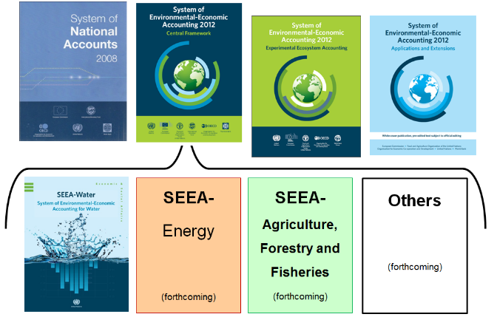
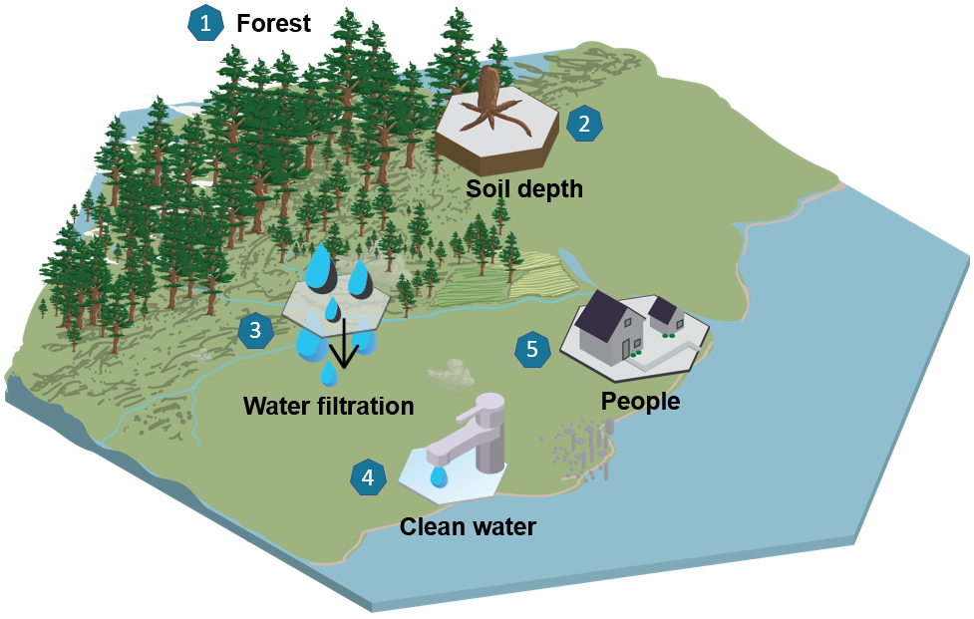
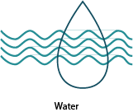
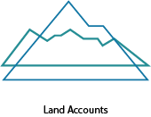
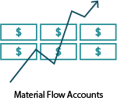
SEEA: Central framework and Ecosystem Accounting
https://seea.un.org/
ESCWA had projects funded by UNDA and XB since 2004 on Environment, Energy and SDGS to provide technical assistance and capacity building to develop pilot accounts with Member Countries on SEEA Water and SEEA Energy.
But the production stopped when the projects ended. Countries do not produce regular accounts.
Thematic Areas
https://seea.un.org/ecosystem-accounting
Notes:
The SEEA has a number of different components.
First there is the SEEA Central Framework which is an international statistical standard to measure the environment and its relationship to the economy. It is fully consistent with the SNA which is the standard to measure the economy, and is essentially a satellite account of the SNA o extend to the environmental dimension.
The SEEA CF has various subsystems, which serve to provide more detailed guidance on accounting for specific environmental assets. Water is the most established, and energy is in the process of being finalized. FAO and UNSD have also developed a SEEA-AFF and is currently under global consultation. More will be developed in time.
Other modules will be developed in due course depending on policy need. In addition, technical notes are being developed to provide more detailed guidance about accounting for specific topics.
In addition, we have the SEEA EEA which is still in the experimental stage, and represents a synthesis of current knowledge on ecosystem accounting.

Slide 5
System of Environmental Economic Accounting (SEEA)
Global Assessment of Environmental-Economic Accounting and Supporting Statistics 2023 Email to NSO from SEEA-DESA
Global Assessment 2022

Slide 6
SEEA status in Arab Countries in 2018
Country SEEA status 2018 | Compiled and/or published accounts? | Funding? | CF account compiled (thematic area) | EEA account compiled (thematic area) | Plans to begin compilation of accounts in new thematic area? | Other notes
Egypt | Planning |  |  |  |  | Priority of water
Iraq | Yes (compilation/publishing status unclear) |  | Water |  |  | Priorities of water, energy and land
Jordan | Planning |  |  |  |  | Received technical assistance and training in 2014, but could not establish a programme at that time; there is a need for more training and more integration with other ministries Priorities are water, energy and waste. Would like to have a field visit to Indonesia to learn about their experience in applying the SEEA.
Kingdom of Saudi Arabia | No |  |  |  |  | Plans of the Department of Environment Statistics are: 1. Participation in UNSD/ESCWA/AITRS training; 2. In 2019, include questions in forms used by the General Authority of Statistics to cover the part of the environmental-economic accounting; 3. Statistics data of environmental-economic accounting will be published in 2020. Priorities of waste, water and energy
Kuwait | No
Oman | No |  |  |  |  | Priorities of water and energy
Palestine | Compiled and published | Periodic funding but are planning to increase staff by three employees | EPEA |  | MFA, water, energy, land, timber, aquatic, water emissions, air emissions, waste, ReMEA, EGSS, taxes, subsidies, Agriculture forestry and fisheries; Plan to do all ecosystem accounts after 2020 | SEEA embedded in NSDS; have received technical assistance for water and waste accounts Priorities of energy and water
Qatar | Planning |  |  |  | Materials, water, energy, land, aquatic, biological, air emissions, water emissions, EPEA, ReMEA, EGSS, taxes, subsidies, agriculture forestry and fisheries | Water and EPEA are highest priority
Sudan | No |  |  |  |  | Priorities of energy and minerals, water and forest
Tunisia | Yes (compilation/publishing status unclear) |  | Water |  |  | Did not respond to Global Assessment, but have water accounts; waste and energy are priorities
Turkey | Compiled and published | Regular funding | MFA, water, energy, timber, air emissions, EPEA, EGGS, taxes |  | Expansion plans for existing accounts | SEEA is in NSDS; DG Forestry did pilot study on ecosystems in 2015 for Bolu, Duzce region via WAVES. Have received technical assistance on CF accounts from Eurostat.
Yemen | No |  |  |  |  | Priorities of water and land

Slide 7
UNSD/UNEP Data Collection of Water Waste Statistics Inform FDES 2002-2021
Prepared by Christoph Rouhana

Slide 8
Waste Water

Slide 9
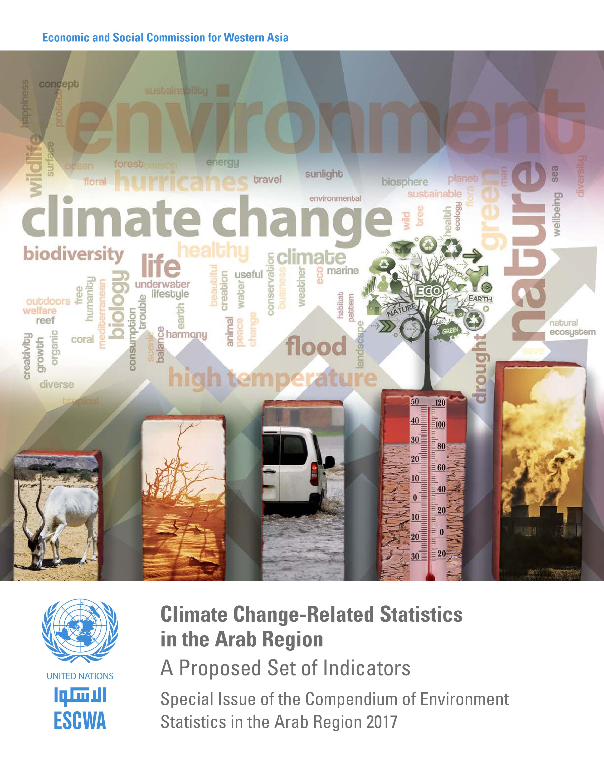
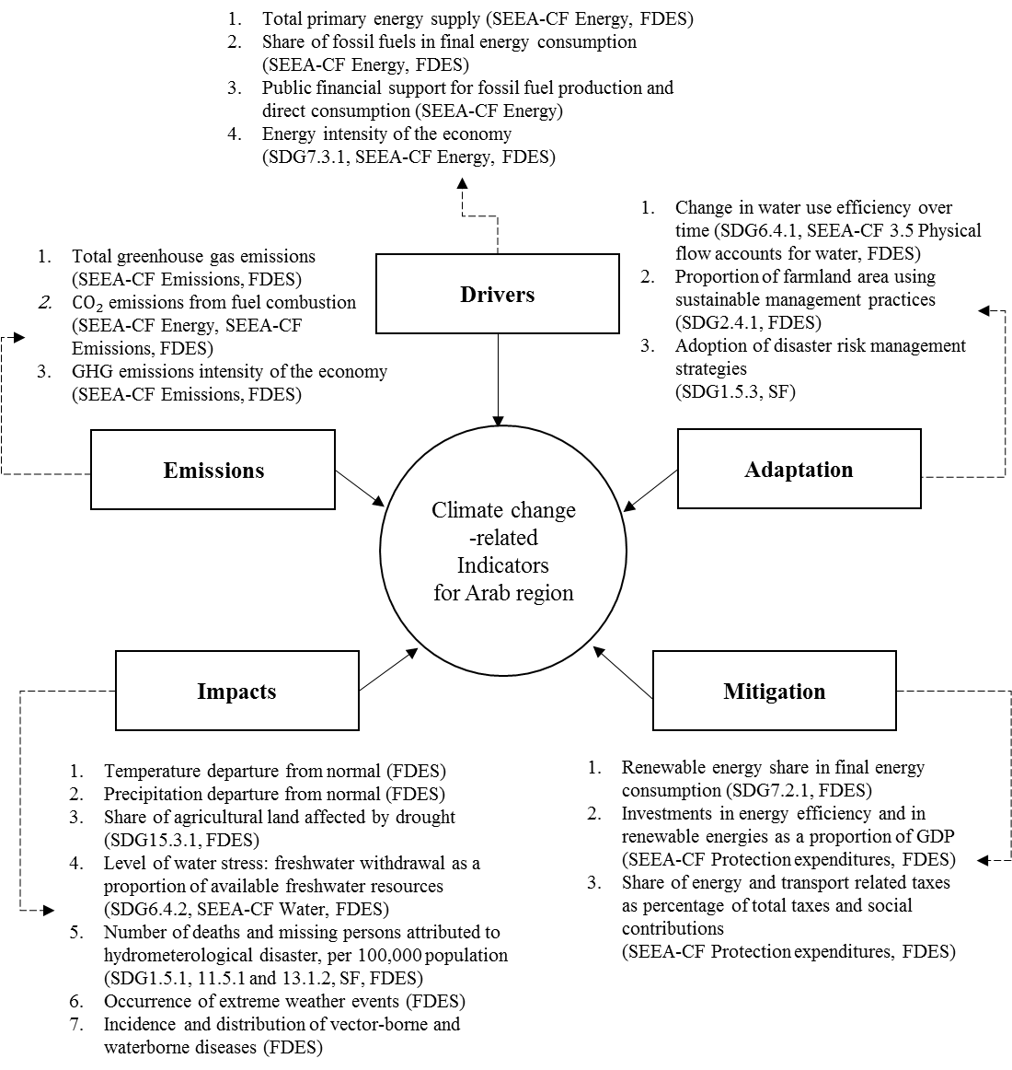
II. Climate Change-Related Statistics in the Arab Region A Proposed Set of Indicators 2017
Building on List of Indicators for the ECE and UNSD
E/ESCWA/SD/2017/3
In Arabic and English
SURVEY OF ECONOMIC AND SOCIAL DEVELOPMENTS IN THE ARAB REGION 2017-2018
Notes:
The Scope of Mitigation and Adaptation were considered more important than Emissions Scope
Concerns about indicators related to fossil fuels and per capita indicators, as those indicators did not reflect “the real picture” in Gulf countries. ESCWA however suggested keeping fossil fuel indicators for global reporting on climate change
On impact-related indicators, floods and rising sea and river levels were of concern. Consequently, ESCWA included in the revised list under ‘impacts’ a new indicator on “Occurrence of extreme weather events” (table 5, indicator 13), and the effects of those events such as desertification, drought, floods, landslides, storm surge, soil erosion, and saline water intrusion.
On “Incidence and distribution of vector-borne diseases” it was suggested to include waterborne diseases, as the risks in Arab countries were clearly documented

Slide 10
Capacity Building on SEEA , Water, Energy, Climate Change and DRR
UNGP LMS: All courses (officialstatistics.org)
SEEA - Central Framework (Arabic)
SEEA - Energy (Arabic)
SEEA - Water (Arabic)
Other Courses
SEEA - In Depth Training on Energy Accounting (Arabic) تدريب متعمّق حول المحاسبة في مجال الطاقة
SIAP on-line training open to ESCWA member states: Compiling Climate Change Indicators: An Accounting Approach
التّدريب الإلكتروني حول الإطار الإحصائي المعني بالكوارث DRSF

Slide 11
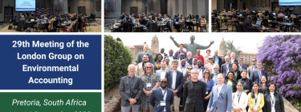
Contribution to Global and Regional Work
ESCWA is member if the following mechanisms:
Expert Group meetings: EGES (Includes CC )
Intergovernmental-UN Committees: UNCEEA and London Group
ISWG on DRS
UNEP-LAS-ESCWA Environment-Related SDGs of Priority for the Arab Region

Slide 12
Building on List of Indicators for the ESCWA and UNSD
Complementarity with Medstat V
Duration: 2022 - 2025
Budget: 3 792 924 EUR
Thematic sectors and Horizontal sectors
Each WG led by a lead country and chaired by a lead coordinator
The Working group on Climate action and biodiversity sector for MEDSTAT V agreed a baseline questionnaire that was sent to the 9 countries to select the most relevant indicators for them in order to focus the activities on them.
In the questionnaire there were the UNSD/ESCWA indicators
(16 Mitigation indicators and 41 Adaptation indicators).
The list of indicators to be worked out during the project will be discussed in the next online working group meeting .
Climate action, biodiversity
Sector | Business Registers and statistics, circular economy, informal economy | Trade and international investments | Energy, transport and sustainable development | Inclusivness: Gender and labour statistics | Migration SURVEY AND statistics | Climate action, biodiversity
Lead country with Lead coordinator and Key experts | Palestine | Morocco | Tunisia | Morocco | Morocco | Egypt
Horizontal sectors
Quality, IT and Information systems, Administrative and new sources, Communication, and HR management

Slide 13
III.New Technologies: Satellite Imagery and Geospatial Information Use in official Statistics on Climate Change and Environment Statistics
Google Earth Engine Project with Egypt on Monitoring Disasters on Land Use in Egypt 2020-2022
ESCWA Geo Statistics Lab: 2022- Current
Component 1: Environmental Conditions and Quality
subcomponent 1.2, Land cover Ecosystems and Biodiversity
Topic 1.2.1 Land cover
Area of land cover By location, By type of land cover (e.g., artificial surfaces including urban and associated areas; herbaceous crops; woody crops; multiple or layered crops; grassland; tree covered areas; mangroves; shrub covered areas; shrubs and/or herbaceous vegetation, aquatic or regularly flooded; sparsely natural vegetated areas; terrestrial barren land; permanent snow and glaciers; inland water bodies; and coastal water bodies and inter-tidal areas) at national (Arab Countries) and subnational by administrative boundaries .
Topic 1.2.2: Ecosystems and biodiversity
d. Protected areas Total, terrestrial and marine (number and area)
Topic 1.2.3: Forests
1.2.3.a. Forest area: Total and By forest type (Natural, Planted Protected forest area Forest area affected byfire)
Component 1: Environmental Conditions and Quality
Sub-component 1.1: Physical Conditions
Topic 1.1.4: Soil characteristics
1.1.4.b. Soil degradation
1.1.4.b.1. Area affected by soil erosion
Component 5: Human Settlements and Environmental Health,
Sub-component 5.1: Human Settlements,
Topic 5.1.5: Environmental concerns specific to urban settlements
5.1.5.f. Extent of roadways

Slide 14
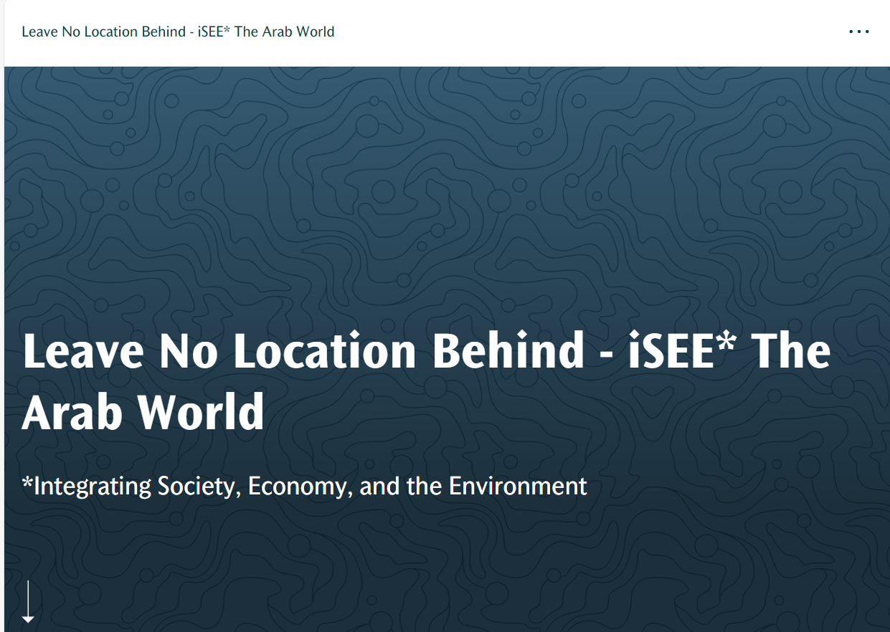
Leave No Location Behind - iSEE* The Arab World (un.org)

Slide 16
Thank you

