Slide 1
Update on Total official support for sustainable development
(TOSSD)
ARABSTAT meeting
8 November 2023
Guillaume Delalande (Guillaume.Delalande@oecd.org) – TOSSD coordinator

Slide 2

What is TOSSD?
The TOSSD statistical measure includes all official resources to promote sustainable development in developing countries. It also includes private finance mobilised by official interventions.
TOSSD reporters
Components considered in TOSSD
Sustainability test
TOSSD framework
Bilateral providers
(traditional and Southern providers)
Official Development Assistance (ODA) flows
Pillar I
Cross-border flows to TOSSD recipient countries
Private Finance Mobilised
Other Official Flows (OOF)
South-South co-operation
Does it support Sustainable Development?
YES
Pillar II
Global and regional expenditures
Triangular co-operation
Multilateral providers
(MDBs and other IFIs, UN agencies, other multilateral organisations)
Spending for International Public Goods (IPGs)
NO
Pillar I
Private finance mobilised by official interventions
Current data availability
https://tossd.online
Complete
Partial
Excluded

Slide 3
History of the TOSSD framework
Key milestones
2022
TOSSD becomes a data source for the new version of SDG indicator 17.3.1.
The 2nd TOSSD dataset (on 2020 activities) is released.
2020
TOSSD is referenced in the G20 FSD framework.
The first TOSSD regular data collection is carried out.
2017
The International TOSSD Task Force is established.
2015
A key political anchorage for TOSSD: the Addis Ababa Action Agenda in July 2015.
2019
First recognition of TOSSD in the G7
A first version of the TOSSD methodology is released.
2021
The tossd.org website and data visualisation tool (https://tossd.online) are launched.
The first TOSSD dataset on 2019 activities is released.
2023
The 3nd TOSSD dataset is released. With +100 reporters, TOSSD now contains more than one million activities.

Slide 4
TOSSD data
USD 47.6 billion* disbursed through +36,000 activities benefiting ARABSTAT’s TOSSD recipient countries** in 2021.
TOSSD totals for 2021
Pillar I
Pillar II
Amounts mobilised
Islamic finance can be reported in TOSSD (e.g., istisna’a, sukuks, musharaka).
USD 299.2 billion
USD 95.4 billion
USD 51 billion
official support
private finance mobilised
For comparison:
  TOSSD in 2019 amounted to 394 USD billion.
USD 395 billion
+ USD 51 billion
gross disbursements
Data available at https://tossd.online/
* Syrian Arab Republic data includes large development finance flows that the Republic of Türkiye reported to the TOSSD Secretariat on 2021 activities, and that mainly consist of support to Syrian refugees in Türkiye. The amount refers to pillar I activities only.
** including Algeria, Comoros, Djibouti, Egypt, Iraq, Jordan, Lebanon, Libya, Mauritania, Morocco, Somalia, Sudan, Syrian Arab Republic, Tunisia, West Bank and Gaza Strip, and Yemen (list of Members of the Arab Monetary Fund).

Slide 5



Why is TOSSD needed?
TOSSD is a data source for the SDG Indicator Framework
The UN has adopted TOSSD as a data source for the SDG indicator 17.3.1. :
17.3.1 Additional financial resources mobilized for developing countries from multiple sources.
Official sustainable development grants
Official concessional sustainable development loans,
Official non-concessional sustainable development loans,
Foreign direct investment
Mobilised private finance (MPF) on an experimental basis, and
Private grants.
SDG target 17.3 seeks to «Mobilize additional financial resources for developing countries from multiple sources»
https://unstats.un.org/sdgs/metadata/?Text=&Goal=17&Target=17.3

Slide 6
TOSSD and government finance statistics
More transparency to recipient countries
For example, for Lebanon
Examples of previously unreported activities
South-South co-operation:
Food assistance to ensure nutrition security after the Beirut explosion by Brazil
Activities beyond ODA for DAC members:
Radiation detection capabilities activities in the Beirut Port
Intercultural and interreligious dialogue
Non-core resources by multilateral organisations:
Strengthening of decent work to mitigate stress factors by International Labour Organisation
753 additional
activities reported
+ 116.4 % in volume terms (compared to OECD statistics on development finance)
TOSSD
USD 2.29 bn.
OECD statistics:
USD 1.06 bn.

Slide 7
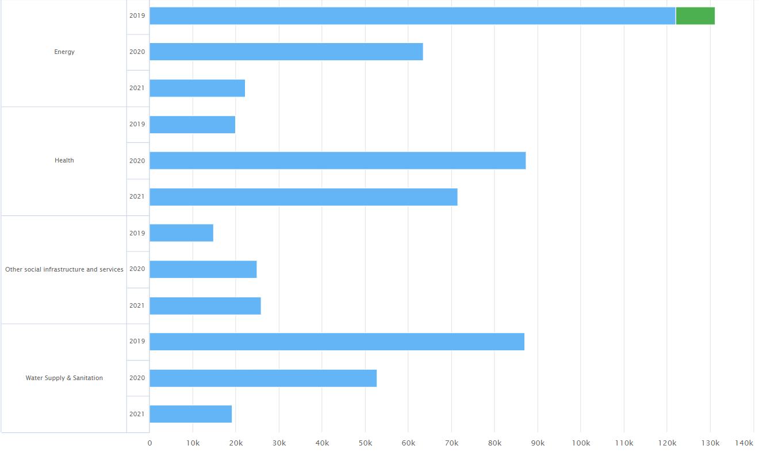
TOSSD and government finance statistics
The TOSSD.online platform offers data on official support by sectors
Mauritania (2019-2021)
Resources allocated to other social infrastructure and services (e.g., social protection, housing) increased by 80%.
Support to health increased by more than 250%.
In thousand USD – current 2021 prices. See data for more than 20 sectors at www.TOSSD.online

Slide 8
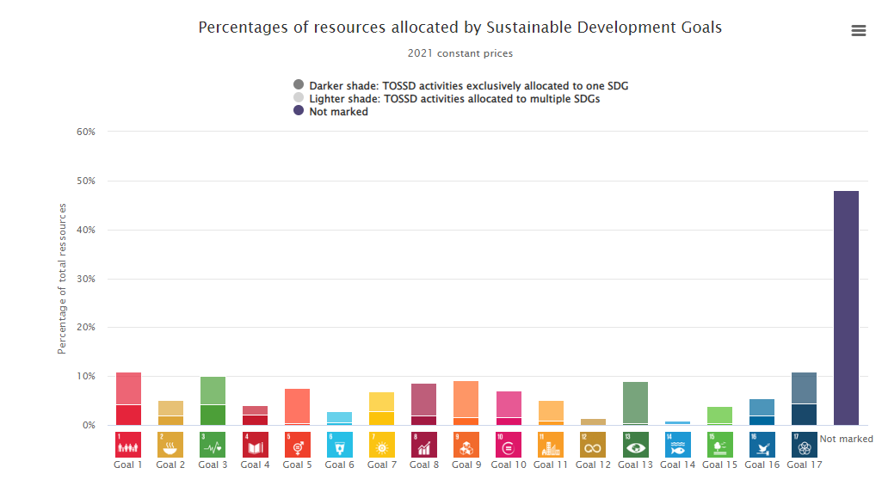
TOSSD and government finance statistics
TOSSD information is available by Sustainable Development Goal
An increase in TOSSD reporting by SDG from 51% in 2020 to 61% of disbursements in 2021.
TOSSD is currently testing an Artificial Intelligence tool to populate and verify SDG targets.
Countries can use TOSSD data for monitoring the support they receive for the implementation of the SDGs (e.g., making of Voluntary National Reviews).
Data available at https://tossd.online/
https://tossd.org/pilot-studies-data-stories/hlpf-voluntary-national-reviews.htm

Slide 9
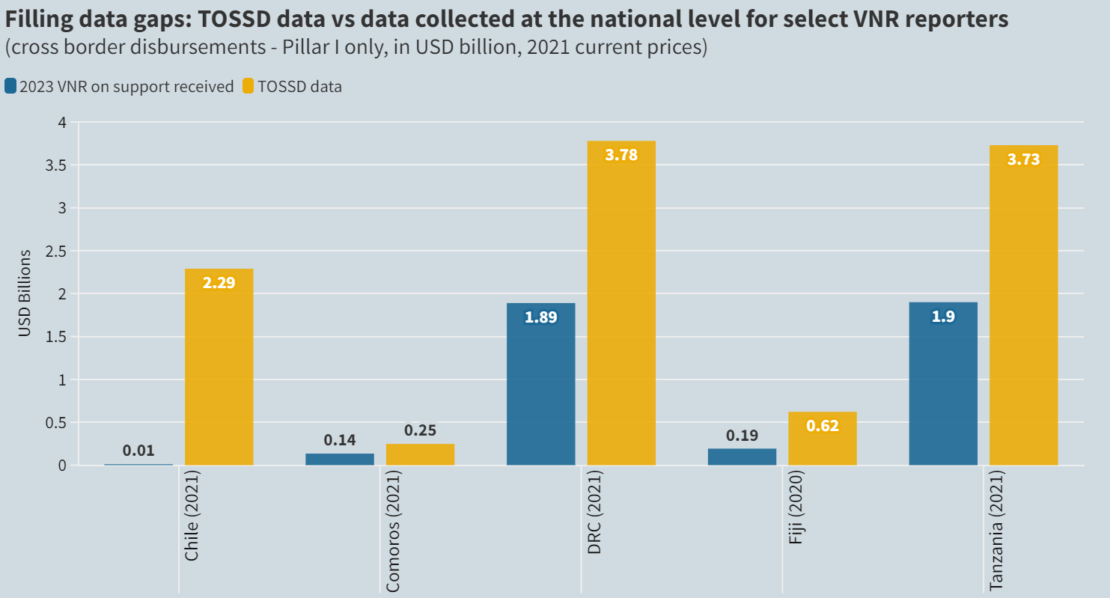
TOSSD and government finance statistics
TOSSD data can help countries complement their national data to prepare UN National Voluntary Reviews – Examples for 2023 National reviews
For Comoros and Tanzania, TOSSD tracked respectively 84% and 96% more disbursements than those reported in their VNRs.
For DRC, Fiji, and Chile, TOSSD provides respectively twice, three times and 200 times more information than presented in the VNR.
https://tossd.org/pilot-studies-data-stories/2023-hlpf-voluntary-national-reviews.htm

Slide 10
A new international Forum on TOSSD is being set up starting 1 January 2024
BODIES OF THE INTERNATIONAL FORUM
GENERAL ASSEMBLY
Members
Observers
Reporters
STEERING GROUP
2 co-Chairs
Balanced composition of 30 members from various stakeholder groups
STATISTICAL WORKING GROUP
OTHER WORKING GROUPS
TOSSD SECRETARIAT (based at the OECD)

Slide 11
TOSSD and ARABSTAT
TOSSD and ARABSTAT – current engagement
Several Arabstat members already engaged in TOSSD:
4 ARABSTAT members report to TOSSD: Kuwait, Qatar, Saudi Arabia and the United Arab Emirates.
Egypt is a member of the TOSSD Task Force and will participate in a TOSSD pilot study in 2024.
4 multilateral organisations covering Arab countries report to TOSSD: Arab Fund, Arab Bank for Economic Development in Africa (BADEA), Islamic Development Bank and SESRIC.

Slide 12
TOSSD and ARABSTAT
TOSSD and ARABSTAT – potential collaboration areas
Report to TOSSD your support to sustainable development:
  South-South cooperation activities
  Islamic Finance instruments benefiting developing countries and/or contributing to global challenges
  Contributions to multilateral organisations
Join as members of the International Forum on TOSSD:
  It is a unique opportunity for developing countries, provider countries and multilateral institutions to shape together the way development official support is measured globally.
Use TOSSD data
  Seven ARABSTAT members (Egypt, Libya, Mauritania, Oman, Palestinian Authority, Syria, and Yemen) are TOSSD recipients and could use TOSSD data in the VNRs that they will present in 2024.
  The UN and other stakeholders have been promoting the use of data sources beyond national administrations to report on the implementation of the SDGs.
Participate in the TOSSD data review mechanism for recipient countries and in our capacity-building seminars.

Slide 13
Thank you
www.tossd.org
www.tossd.online
Guillaume.Delalande@oecd.org

