Slide 1
Human Capital Statistics
10th Meeting of the Steering Committee of the Arab Statistics Initiative (Arabstat) ABU DHABI – UAE, 8-9 November 2023
DR. ATILLA KARAMAN DIRECTOR, STATISTICS & INFORMATION DEPARTMENT
Statistical, Economic and Social Research and Training Centre for Islamic Countries (SESRIC)

Slide 2
Outline
Relevancy
Overview of Human Capital Statistics in OIC Countries
Efforts of SESRIC in Human Capital Statistics
Potential Future Directions
www.sesric.org
2/11

Slide 3
Relevancy
OIC-2025 Programme of Action
OIC STI Agenda 2026
Prioritised SDGs at the OIC level
OIC Summits on Science & Technology Islamic Conferences of Ministers of Higher Education & Scientific Research
www.sesric.org
3/11

Slide 4
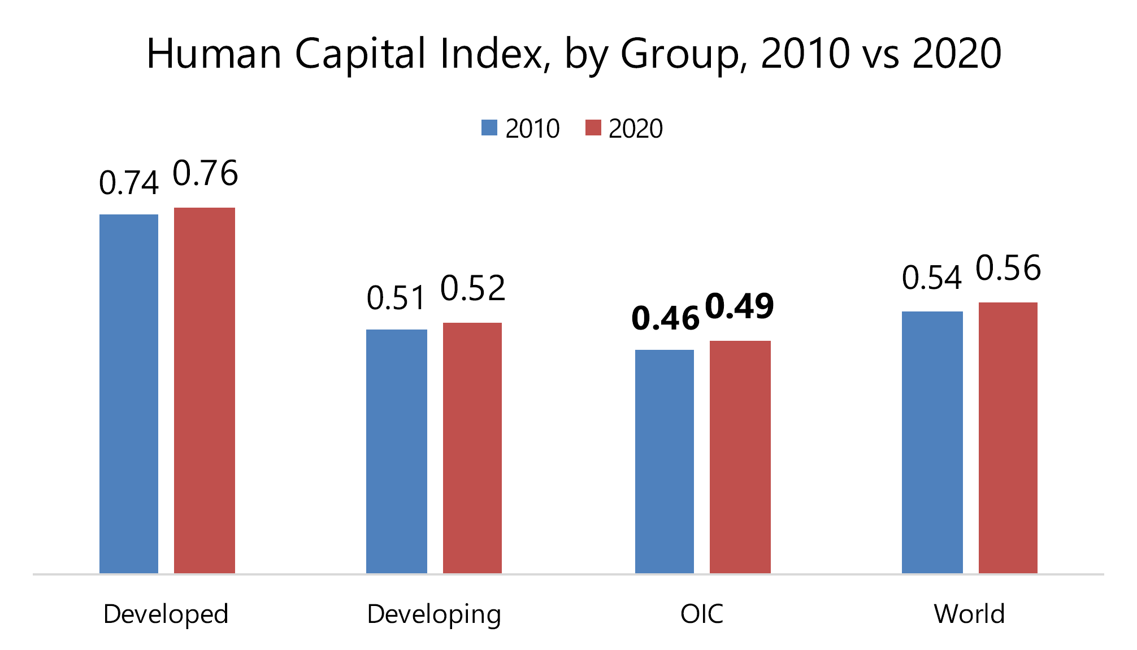
Overview of Human Capital Statistics in OIC Countries
Compared to other groups, Human Capital Index (HCI) average
of OIC countries group is lower than the other groups in 2020
In 2020, OIC countries group recorded a lower HCI average compared to the others.
3 percentage point increase in the 2010-2020 period.
On average, a child born in the OIC countries group will be 49% as productive when s/he grows up as s/he could be if she enjoyed complete education and full health.
www.sesric.org
4/11

Slide 5
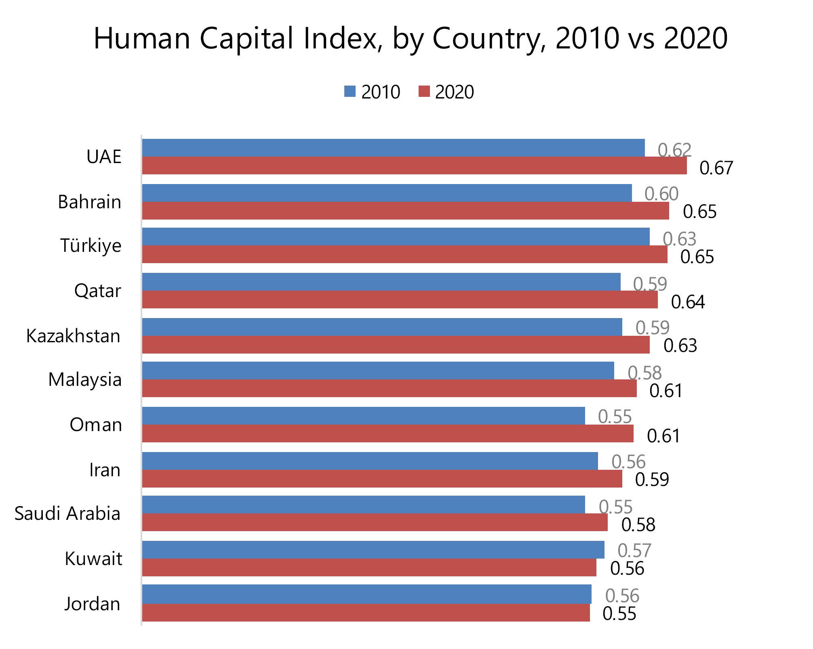
Overview of Human Capital Statistics in OIC Countries
The OIC countries in the Gulf and some parts of Asia recorded scores above the World average but still lower than the Developed countries group average
In 2020, HCI scores of only 16 OIC countries were higher than the world average. It was 11 in 2010.
From 2010 to 2020, 24 OIC countries showed a positive performance in their HCI scores.
www.sesric.org
4/11

Slide 6
Efforts of SESRIC in Human Capital Statistics
OIC Statistical Commission
SESRIC StatCaB Programme
OICStat Database
Statistical Publications
www.sesric.org
9/11

Slide 7
Potential Future Directions
Strengthen education and skills data collection
Expand health outcomes indicators
Link individual-level data across domains
Build national statistical capacity
Make data more open and usable
www.sesric.org
10/11

Slide 8
Thank you
www.sesric.org
cabinet@sesric.org statistics@sesric.org
@sesric @oicstatcom
@sesric1978 @oic_statcom

