Slide 1
Food Security Statistics
10th Meeting of the Steering Committee of the Arab Statistics Initiative (Arabstat) ABU DHABI – UAE, 8-9 November 2023
DR. ATILLA KARAMAN DIRECTOR, STATISTICS & INFORMATION DEPARTMENT
Statistical, Economic and Social Research and Training Centre for Islamic Countries (SESRIC)

Slide 2
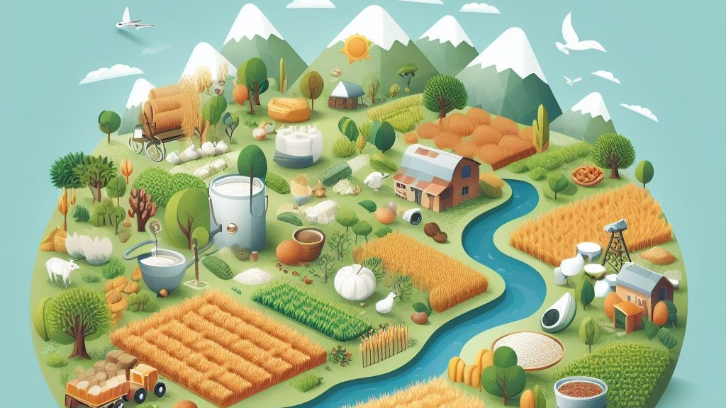
Outline
Relevancy
Overview of Food Security Statistics in OIC Countries
Efforts of SESRIC in Food Security Statistics
Potential Future Directions
www.sesric.org
2/11

Slide 3
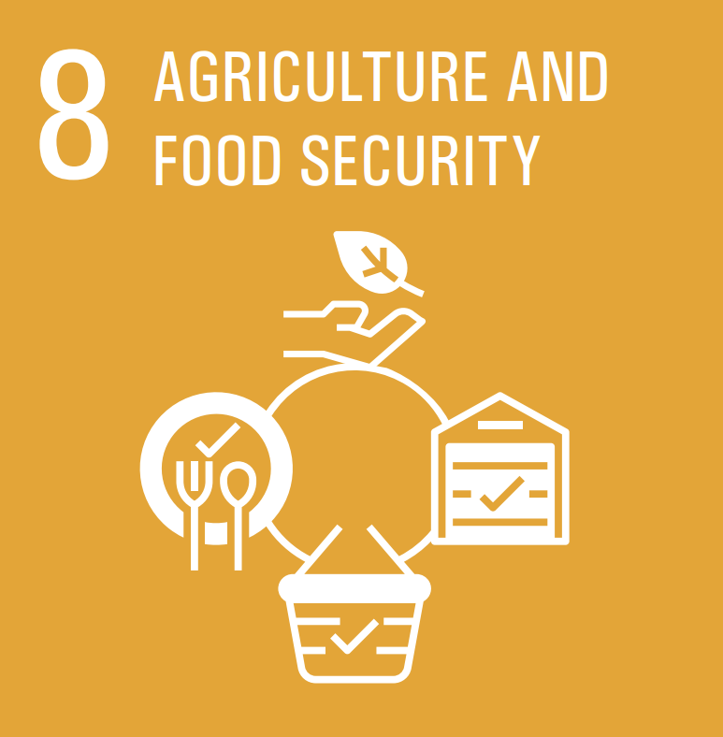
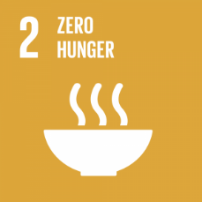
Relevancy
OIC-2025 Programme of Action
OIC STI Agenda 2026
Prioritised SDGs at the OIC level
OIC Ministerial Conferences on Food Security & Agricultural Development
www.sesric.org
3/11

Slide 4
Overview of Food Security Statistics in OIC Countries
Global Food Security Index (GFSI) 2022 shows diverse pictures of the state and trends of food security in OIC countries
VERY GOOD |  |  | WEAK
SCORE 80+ |  | Δ | SCORE 40-54.9 |  | Δ
GOOD |  |  | Bangladesh | 54 | -2.5
SCORE 70-79.9 |  | Δ | Pakistan | 52.2 | -1.2
UAE | 75.2 | 3.6 | Mali | 51.9 | 2.2
Qatar | 72.4 | -0.6 | Senegal | 51.2 | 1.2
Kazakhstan | 72.1 | 3.9 | Burkina Faso | 49.6 | -1
Oman | 71.2 | -2.1 | Benin | 48.1 | 1.7
Bahrain | 70.3 | 0.8 | Uganda | 47.7 | 3
MODERATE |  |  | Mozambique | 47.3 | 3
SCORE 55-69.9 |  | Δ | Cote d'Ivoire | 46.5 | -4.3
Malaysia | 69.9 | 2.7 | Cameroon | 46.4 | -1.7
Saudi Arabia | 69.9 | 2.6 | Niger | 46.3 | -4.5
Jordan | 66.2 | 0.9 | Togo | 46.2 | -1.6
Turkey | 65.3 | 0.1 | Guinea | 45.1 | 1
Kuwait | 65.2 | -2.8 | Chad | 43.2 | 0.9
Morocco | 63 | -0.5 | Sudan | 42.8 | 2.7
Tunisia | 60.3 | 1.2 | Nigeria | 42 | -2.7
Indonesia | 60.2 | -3.4 | Sierra Leone | 40.5 | 0.4
Azerbaijan | 59.8 | 1.6 | Yemen | 40.1 | 1.2
Algeria | 58.9 | 0.4
Uzbekistan | 57.5 | 5.4 | VERY WEAK
Tajikistan | 56.7 | 4.4 | SCORE 0-39.9 |  | Δ
Egypt | 56 | 5.1 | Syria* | 36.3 | -3.6
In 2022, 5 OIC countries having “good” food security; 13 “moderate” food security; 18 “weak” food security; one with “very weak” food security.
Top performers since 2018 was made in Uzbekistan, Egypt, Tajikistan, Kazakhstan, and UAE.
www.sesric.org
4/11

Slide 5
Overview of Food Security Statistics in OIC Countries
Undernourished population increased due to COVID-19 and other stressors
Prevalence of Undernourishment (% of Total Population), 2001-2020
Undernourished population in OIC countries has declined from 15.6% in 2001 to a record-low of 10.0% in 2017. Yet, still higher than those of non-OIC developing countries and world.
Hunger population increased to 11.2% in 2020, resulting in an additional of more than 20 million undernourished people.
In 2020, there were 203 million undernourished people in OIC, equivalent to 28% of global undernourished people.
www.sesric.org
5/11

Slide 6
Overview of Food Security Statistics in OIC Countries
Malnutrition continues to be an issue in OIC member countries
Nutritional Status of Under 5 Children
(% of total children under-5), 2021
Stunting is the most prevalent malnutrition type in OIC countries with 26.5% of children under-5.
Much work to be done for the Global Nutrition Targets 2025, which is to reduce and maintain childhood wasting to less than 5% by 2025.
Overweight is the least of the other types in OIC. Overweight (overnutrition) is typically the issue of higher income countries.
www.sesric.org
6/11

Slide 7
Overview of Food Security Statistics in OIC Countries
Healthy diet becomes more expensive, many people cannot afford it
Cost of Healthy Diet (US$/person/day), 2017-2020
People Unable to Afford a Healthy Diet (% of population), 2020
www.sesric.org
7/11

Slide 8
Overview of Food Security Statistics in OIC Countries
Around 76 million people in 10 OIC countries are
in food crisis or worse (IPC Phase 3 or above)
Low-Income Food-Deficit Countries (LIFDCs) and Countries Needing External Assistance for Food
Afghanistan | Guinea | Niger | Sudan
Bangladesh | Mali | Senegal | Syria
Burkina Faso | Mauritania | Sierra Leone | Uganda
Cameroon | Mozambique | Somalia | Yemen
Chad
Low-Income Food-Deficit Countries (LIFDCs)
Benin | Gambia | Kyrgyzstan | Togo
Comoros | Guinea-Bissau | Tajikistan | Uzbekistan
Cote d'Ivoire
Countries Needing External Assistance for Food
Djibouti | Libya | Pakistan
Iraq | Nigeria
Latest food security projection pointed out that millions of people in 10 OIC countries (Afghanistan, Bangladesh, Djibouti, Lebanon, Mozambique, Pakistan, Somalia, Sudan, Uganda, and Yemen) are in food crisis or worse (IPC Phase 3 or above).
There are 31 OIC countries are either classified as “Low-income Food Deficit Country” (LIFDC), “Countries in Crisis Requiring External Assistance“, or both.
Main food insecurity drivers: Global economic downturn, climate-related hazards (e.g., drought, flood, pest), conflicts and insecurities, displaced population
www.sesric.org
8/11

Slide 9
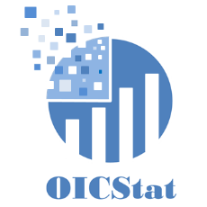
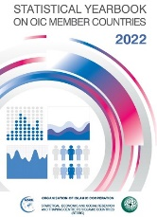
Efforts of SESRIC in Food Security Statistics
OIC Statistical Commission
SESRIC StatCaB Programme
OICStat Database
Statistical Publications
www.sesric.org
9/11

Slide 10
Potential Future Directions
AGRISurvey
World Programme for the Census of Agriculture
FIES
Food Balance Sheets
SEEA-AFF
www.sesric.org
10/11

Slide 11
Thank you
www.sesric.org
cabinet@sesric.org statistics@sesric.org
@sesric @oicstatcom
@sesric1978 @oic_statcom

