Slide 1

Environmental Statistics and the Green Economy
10th Meeting of the Steering Committee of the
Arab Statistics Initiative (Arabstat)
ABU DHABI – UAE, 8-9 November 2023
DR. ATILLA KARAMAN
DIRECTOR, STATISTICS & INFORMATION DEPARTMENT
Statistical, Economic and Social Research and
Training Centre for Islamic Countries (SESRIC)

Slide 2

Outline
Relevancy
Overview of Environmental & Green Economy Statistics in OIC Countries
Efforts of SESRIC in Environmental Statistics
Potential Future Directions
www.sesric.org
2/11

Slide 3
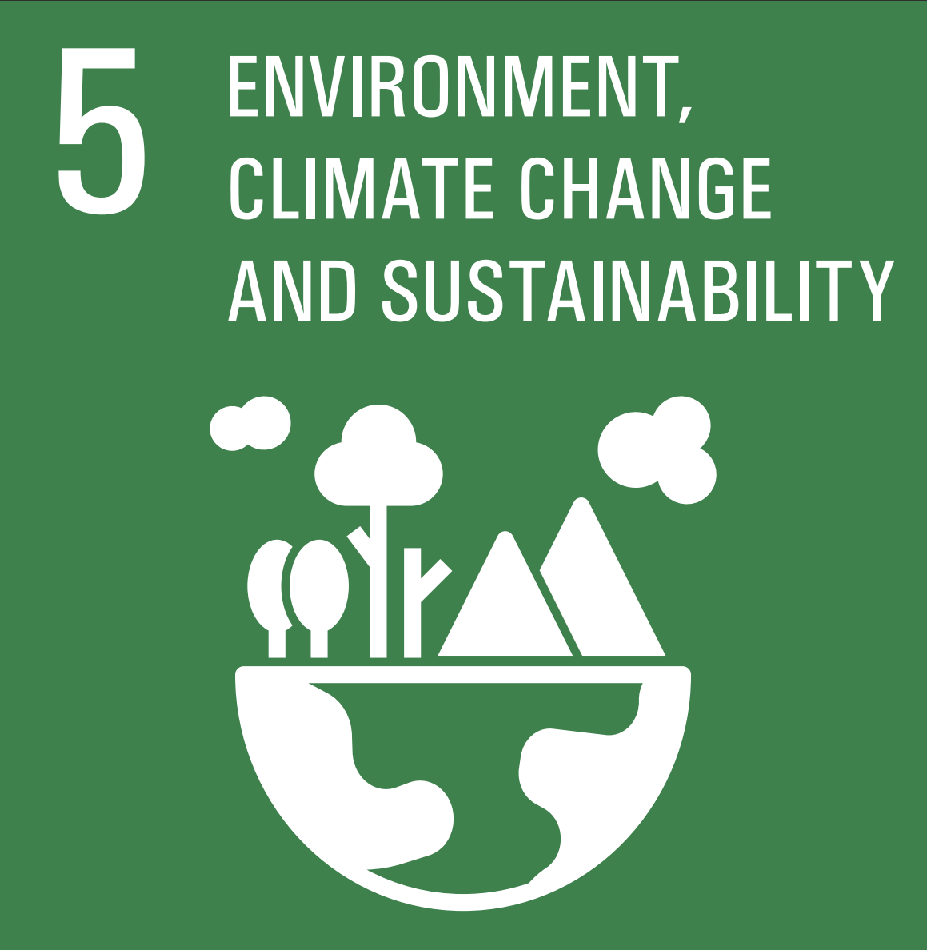

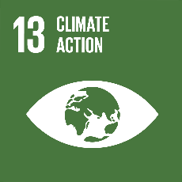

Relevancy
OIC-2025 Programme of Action
OIC STI Agenda 2026
Prioritised SDGs at the OIC level
OIC Ministerial Conferences on Environment
www.sesric.org
3/11

Slide 4
Overview of Environmental &
Green Economy Statistics in OIC Countries
Environment Performance Index (EPI) 2022
The 2022 EPI, maintained by Yale University, provides a data-driven summary of the state of environment around the world.
Ranks 180 countries on 3 policy objectives – environmental health, ecosystem vitality, and climate change
EPI provides a scorecard that highlights leaders and laggards in environmental performance – or in addressing the environmental challenges
Source: 2022 Environmental Performance Index. Yale Center for Environmental Law & Policy. epi.yale.edu.
www.sesric.org
4/11

Slide 5
Overview of Environmental &
Green Economy Statistics in OIC Countries
Environmental performance of OIC lags behind the rest of the world
Source: SESRIC staff calculation based on data from the 2022 EPI. (epi.yale.edu)
www.sesric.org
5/11

Slide 6
Overview of Environmental &
Green Economy Statistics in OIC Countries
Among OIC countries, UAE leads the environmental performance in 2022, while Afghanistan showed as the best improvement in the last decade
Source: SESRIC staff calculation based on data from the 2022 EPI. (epi.yale.edu)
www.sesric.org
6/11

Slide 7
Overview of Environmental &
Green Economy Statistics in OIC Countries
Climate policies in OIC countries
All OIC countries have at least one climate related law and policy.
To limit global warming to 1.5°C, emissions must be reduced by 45% by 2030 and reach net-zero by 2050.
There are 35 OIC countries committed in net-zero target in various ways.
The majority of which still in discussion / declaration phase.
5 countries already achieved net-zero: Benin, Comoros, Gabon, Guyana, and Suriname.
3 countries have net-zero formalized: Tunisia, Maldives and Türkiye.
www.sesric.org
7/11

Slide 8
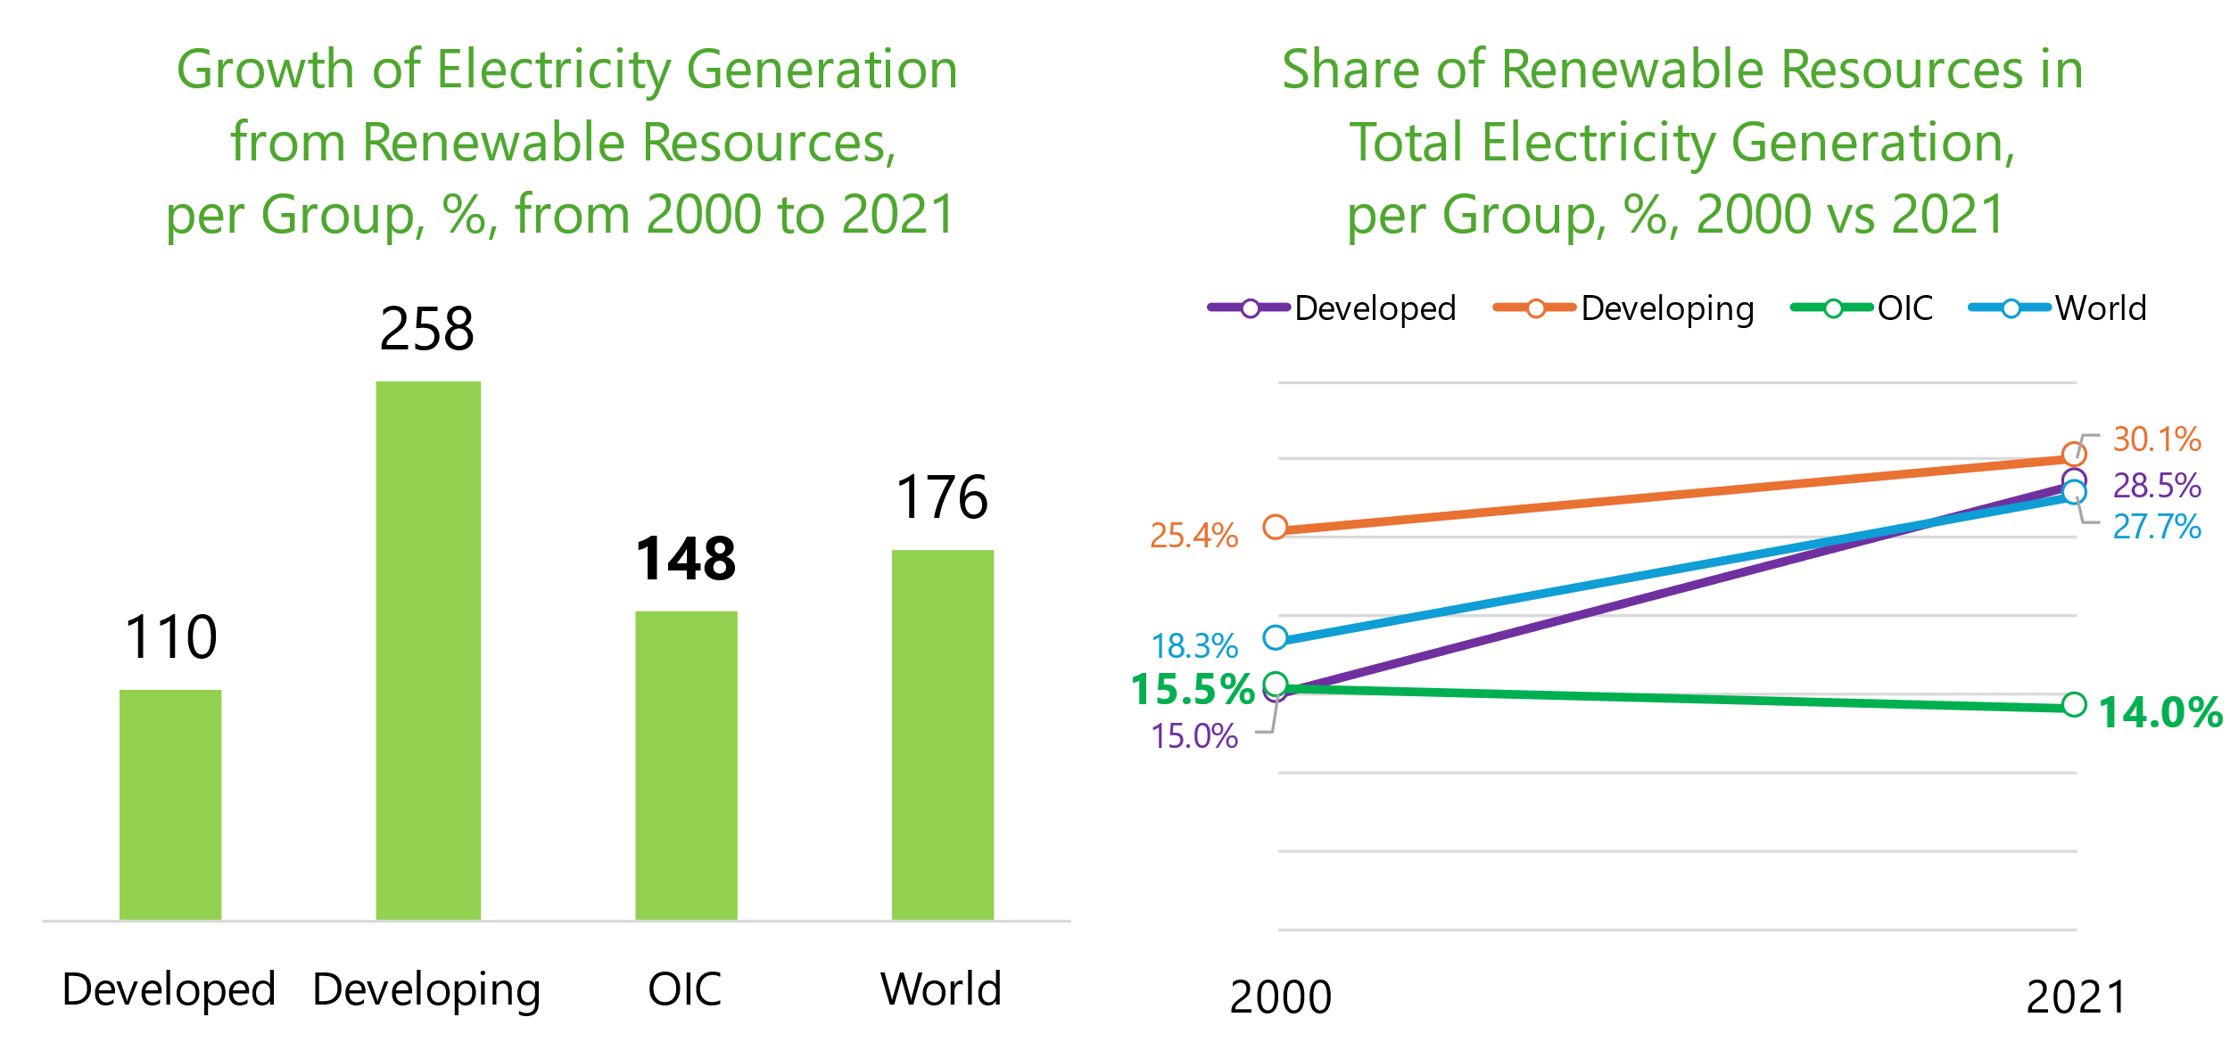
Overview of Environmental &
Green Economy Statistics in OIC Countries
From 2000 to 2021, electricity generation from renewable resources increased in the OIC but its share in total electricity generation declined.
www.sesric.org
8/11

Slide 9


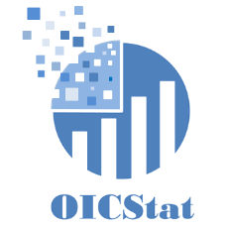
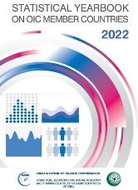
Efforts of SESRIC in Environmental Statistics
OIC Statistical Commission
SESRIC StatCaB Programme
OICStat Database
Statistical Publications
www.sesric.org
9/11

Slide 10
Potential Future Directions
National climate change statistical programmes
Strengthen the capacities
Increase involvement
Produce and disseminate climate change statistics
www.sesric.org
10/11

Slide 11






Thank you
www.sesric.org
cabinet@sesric.org
statistics@sesric.org
@sesric
@oicstatcom
@sesric1978
@oic_statcom

