Slide 1
Economic and Social Commission for Western Asia
The Role of new technologies in advancing official statistics
Meeting of the
Technical Committee of the Arab Statistics Initiative
“Arabstat”
Haidar Fraihat, Ph.D. United Nations – ESCWA November 9, 2022

Slide 2
BUT.. What is going on in the Data Science world.
The core business of NSOs is to produce timely statistics and data to their
government and to disseminate it effectively .
New digital technologies provided additional data sources, and unconventional methodologies beyond surveys to tap into the wealth of data.
Statistics are traditionally obtained via surveys and questionnaires:
Population
What is going on around in the Data World??
XLS Format
Connected citizens now provide data from:
Environment
A Storm in a Cup
NSO Databases:
APIs
Local
Cloud
Mobile phones
Energy
Expert Groups
NSOs
Data
CSV
Files
NGOs
Open Data
Thinks Tanks
Social media
Poverty
Fintech transactions
Technology
PDF Documents
CCTV systems
Gender
Smart watches
Online activity
Dissemination channels
Etc.

Slide 3
At ESCWA, we are developing a data ecosystem that leverages NSOs statistics as a data source, while capitalizing on new digital technologies to go beyond data collection.
We introduced 4 additional data layers:
Data Sources
Enterprise Data
Warehouse & Data Lake
Data Marts Layer
Analytics Layer
Data Access Layer
Contextualized data to
Serve Particular needs
Centralized Data Portal to access ESCWA Data Services
(one-stop shop)
Operational Systems
ESCWA Staff
Trade Flows
XLS Format
ETL
NSO Databases:
APIs
Local
Cloud
NSOs
Data
CSV
Files
PDF Documents
Statistical Systems/Data Providers/Member States
(External and Internal)
SDG Gateway
MS, Partners, etc.
UN Secretary-General’s Data Strategy
Portals, Data Aggregators
Unstructured Data Sources (Web, News, Images, e-Discussions, etc.)
Raw data, summary data,
and metadata
GIS, MPI, etc.
UN-ESCWA Data Strategy
Sentiment Analysis
Data Solutions Team:

Slide 4
28 000 subscribers watching on Netflix
1.6 million USD spent online
I
II
III
IV
A Minute on the Internet
500 hours of content uploaded on YouTube
9 132 connections made on LinkedIn
V
VI
69 million messages sent on WhatsApp
197.6 million emails sent
Data from Statista: https://www.statista.com/chart/25443/estimated-amount-of-data-created-on-the-internet-in-one-minute/

Slide 5
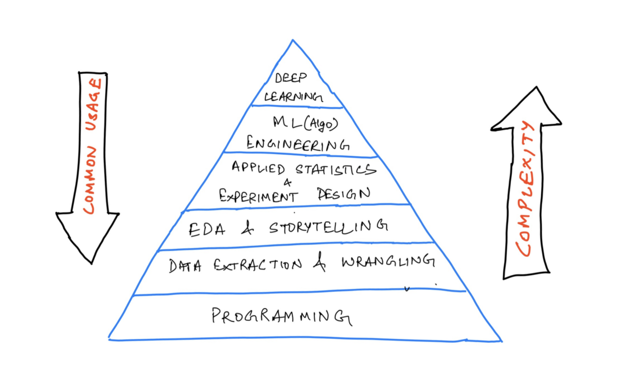

Slide 6
Takeaways
The new normal in Statistics
1
NSOs vs. NSSs vs. MNOs
2
Rethinking governance
3
New careers in Statistics
4
Data ecosystems vs.
statistical silos
5

