Slide 1

COVID-19 challenges for labour force statistics
Kieran Walsh, ILO Department of Statistics 9th November, 2022

Slide 2
Challenges for labour statistics due to COVID_19
Maintaining data collection
Definitions and measurement guidance
Continuing to produce relevant data

Slide 3
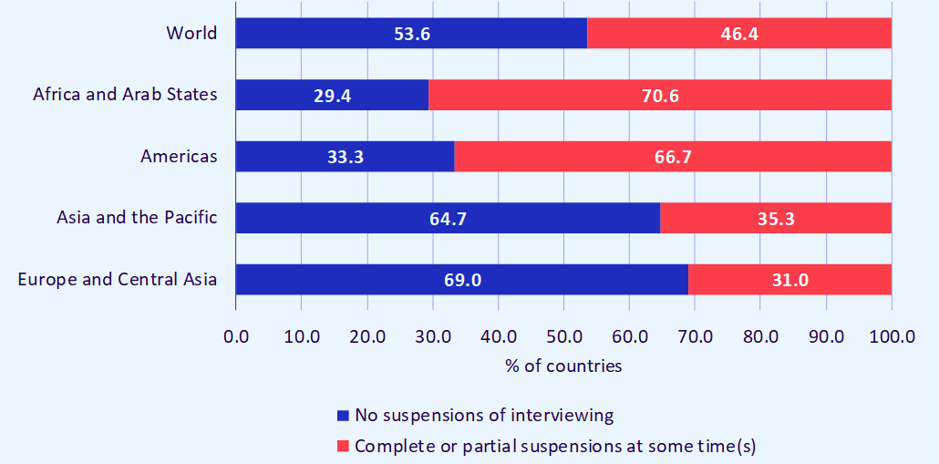
Data collection disruption (based on 110 countries)
  Nearly half of all countries had to suspend LFS interviewing
  Up to 70% of countries in some regions (limited coverage in Arab States)
  Less disruption in countries with regular data collection and remote interviewing (e.g. telephone interviewing)

Slide 4
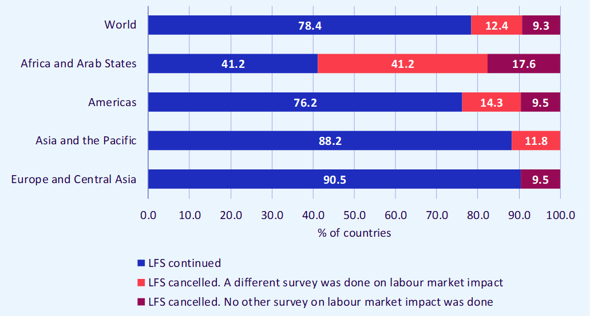
Data collection disruption contd.
  22% of countries cancelled a LFS (59% in Africa) – most did an alternative survey on labour market impacts

Slide 5
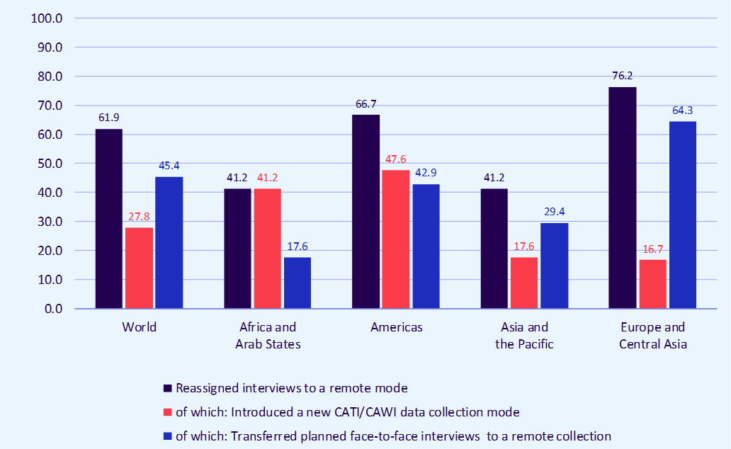
Data collection disruption contd.
  The majority of countries increased use of remote data collection
  62% globally, 67% in Americas
  Nearly half of all countries in Africa and the Americas introduced a new remote mode – in Europe more common to make increased use of existing remote modes

Slide 6
Other themes
  More than half of all countries added questions to their LFS to collect extra information (over 70% in Americas)
  Some countries also did additional surveys and/or removed questions
  Around 20% had to cancel publications or remove indicators
  However, the majority of countries did manage to complete planned LFS
About half the countries who did not use remote modes before introduced them in 2020 (27 countries) - only half of those expected to keep them
More recent information suggests telephone interviewing will increase but many countries had difficulty to get contact details
Substantial investment and development needed to fill this gap
Mixed mode collection with panel design helps where possible

Slide 7
Definitions and measurement guidance

Slide 8
Challenge 2: Definitions and measurement guidance
A range of challenges related to statistical definitions
E.g. clarification of criteria related to temporary absence and affirming existing standards on unemployment
Also guidance on additional indicators and data collection
https://www.ilo.org/wcmsp5/groups/public/---dgreports/---stat/documents/publication/wcms_741145.pdf
Also new guidance requested on concepts such as teleworking
https://www.ilo.org/wcmsp5/groups/public/---dgreports/---stat/documents/publication/wcms_747075.pdf

Slide 9
Maintaining relevance

Slide 10
Challenge 3: Maintaining relevance
Continuance of existing indicators on employment and unemployment highly valuable
However COVID-19 further emphasised the need for wider focus
  ILO COVID-19 monitors focus on loss in total hours worked
  https://www.ilo.org/global/topics/coronavirus/impacts-and-responses/lang--en/index.htm
  Statistics on absences from work and reasons for absence
  Additional indicators on labour underutilization (e.g. potential labour force)
Potential to capture additional information on COVID-19 impacts
  https://www.ilo.org/wcmsp5/groups/public/---dgreports/---stat/documents/publication/wcms_745658.pdf

Slide 11
Summary messages and lessons learned
Maintaining data collection was very challenging
Focus on data collection mode – changes need to be well planned and implemented to be sustainable – much has been learned
Face to face collection continues to play an important role
Definitions needed to be reviewed and expanded
Existing definitions remain key but should be supplemented and some key clarifications were required to reflect COVID-19 realities
Expanded range of statistics needed
No single indicator can fully capture all COVD-19 labour market impacts
Additional indicators on working time, absences, employment loss etc. highly useful
Supplementary sources also useful (rapid surveys, admin sources where available)

