Slide 1
Statistical Challenges During Pandemics
Virtual 9th Meeting of the Arab Statistics Initiative “Arabstat”, 9-10 November 2022
Elizabeth Holmquist, IFC Executive, Federal Reserve Board
Robert Kirchner, IFC Executive, Deutsche Bundesbank
The views expressed are those of the authors and do not necessarily reflect those of the BIS or the IFC or their respective institutions

Slide 2
Outline
Statistical Supply and Demand Factors during Covid-19
  Demand: New Data Needs
  Supply: Disruptions and Challenges
Statistical Responses to the Pandemic
A Wake-Up Call for Producers of Official Statistics

Slide 3
1. I. Demand: New Data Needs
Non-standard Indicators/ New Data Sources
Higher Frequency Indicators
Reduce Publication Lag
Design and publish indicators reflecting the pandemic and its consequences
Publication lag of roughly 4 to 8 weeks after the end of the month for industrial production, retails sales
Traditional Macroeconomic Indicators: Annual/Quarterly (national accounts), at best monthly (unemployment, industrial production, Consumer Price Index)
→ too low frequency to monitor macroeconomic developments related to spread of Covid-19

Slide 4
1. II. Supply: Disruptions and Challenges
Distortion of traditional links between economic variables
  Major policy interventions impact spending, prices, credit, and monetary base . . .
Compilation Difficulties
Changing household spending patterns
Time series effects
Unavailable source data
Low survey response rates due to business closures
Impossibility of face-to-face interviews
Covid-19 has led to higher data uncertainty and the risk of increasing bias/over estimation

Slide 5
2. Statistical Responses to the Pandemic
Addressing timeliness and frequency demands, examples:
  Mobility data → household behaviour
  Energy consumption data → industrial activity
  (Online) Payments data → retail sales/consumption
Renewed push for alternative data sources and sharing
  Web-based indicators and other “organic“ data (sensors, satellites etc.) → mostly private
  Large administrative data-sets (public registers, tax files, supervisory reports) → publically produced, but not fully exploited for statistical purposes

Slide 6
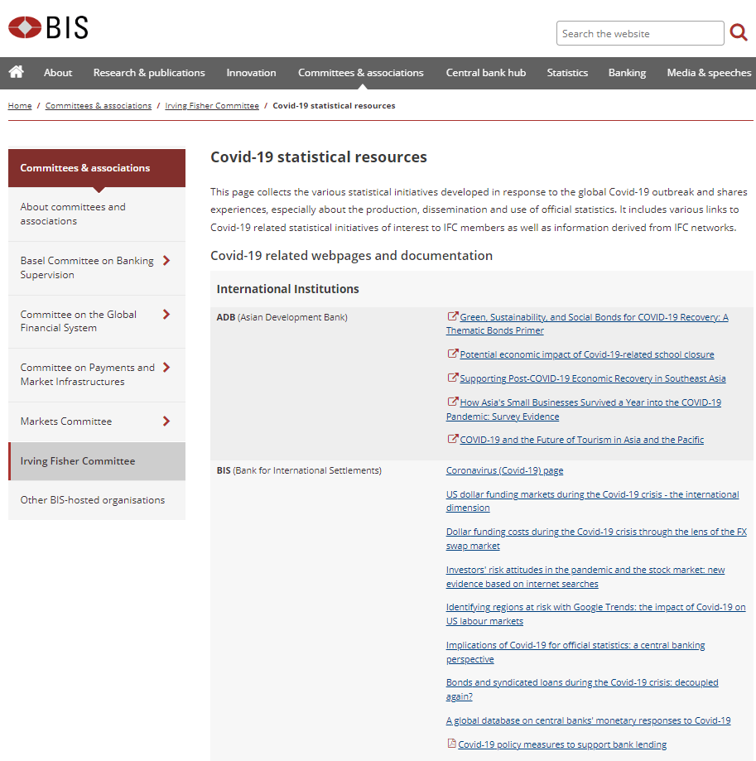
2. Statistical Responses to the Pandemic: IFC Members’ Activities
Covid-19 related statistical resources from about 45 international and national institutions as well as IFC members
More than 100 resources of different kinds
  New data series
  Explanatory notes (e.g., on Consumer Price Index compilation during the pandemic)
  National/Institutional resource collections
  Summary pages and dashboards
Access to various methodological issues (e.g., data sharing, survey methodology) is restricted to IFC members via secure eBIS

Slide 7
3. A wake-up call for producers of official statistics: The statistical value chain
A) Collection
Need for alternative data types to replace or complement traditional collection methods →
Alternative data sources
B) Compilation
Increased data needs and information flood with strained resources → Innovation and Efficiency
C) Dissemination
New Data Series, larger amount and easier access → Require more and better dissemination standards
Better access to private sector and administrative data would allow statisticians to benefit from all available information
Increased digitalization, wider use of AI, and machine learning techniques (for instance, linking large datasets) can increase efficiency in the compilation phase, therefore reducing publication lags
Fostering standardization (LEI, SDMX, INEXDA template for micro datasets) would help users analyse data and speed the delivery of key insights to policy makers
Recommendations 13 (Access to Private and Administrative Data) & 14 (Data Access and Data Sharing, including the Possible Development of an International Microdata Standard) of the new G20 Data Gaps Initiative would facilitate progress in all 3 stages of the statistical value chain

Slide 8
Key Takeaways
Coping with unprecedented shocks requires tapping into new information sources, often held by private actors and government agencies
Better access to data generated by the private sector, wider use of AI techniques in the compilation phase and standardized data publication and international data sharing in the distribution phase could transform the whole production chain of official statistics, making it faster and more resilient.
The way forward could benefit from international cooperation.
  Access to privately held data and government data will be further elaborated in the framework of the new G20 Data Gaps Initiative.
  The IFC member network can help facilitate knowledge sharing and the exchange of best practice

Slide 9
“The trouble with our times is that the future is not what it used to be”
    Paul Valery (French poet, essayist and philosopher, as quoted by De Beer, B., & Tissot, B. (2020))

Slide 10
Appendix: References
Biancotti, C., Rosolia, A., Veronese, G., Kirchner, R., & Mouriaux, F. (2021). Covid-19 and official statistics: a wakeup call?. Bank of Italy occasional paper, (605).
Tissot, B., & De Beer, B. (2021). Implications of Covid-19 for official statistics: a central banking perspective. Theoretical Economics Letters, Vol.11 No.4, August.
Bank for International Settlements: Covid-19 Statistical Resources:
https://www.bis.org/ifc/covid19.htm -
Quirós-Romero, G. (2022). A New G20 Data Gaps Initiative – a statistical response to urgent policy needs. Presentation at 53RD SESSION OF THE UNSC - SIDE EVENT, FEBRUARY 23, 2022 https://seea.un.org/sites/seea.un.org/files/a_new_g20_data_gaps_inititative-a_statistical_gabriel_quiros_imf.pdf -
Rosolia, A., S. Stapel-Weber and B. Tissot (2021). New developments in central bank statistics around the world. Statistical Journal of the IAOS, vol. 37, no. 4, pp. 1055-1060.

